Slide 1
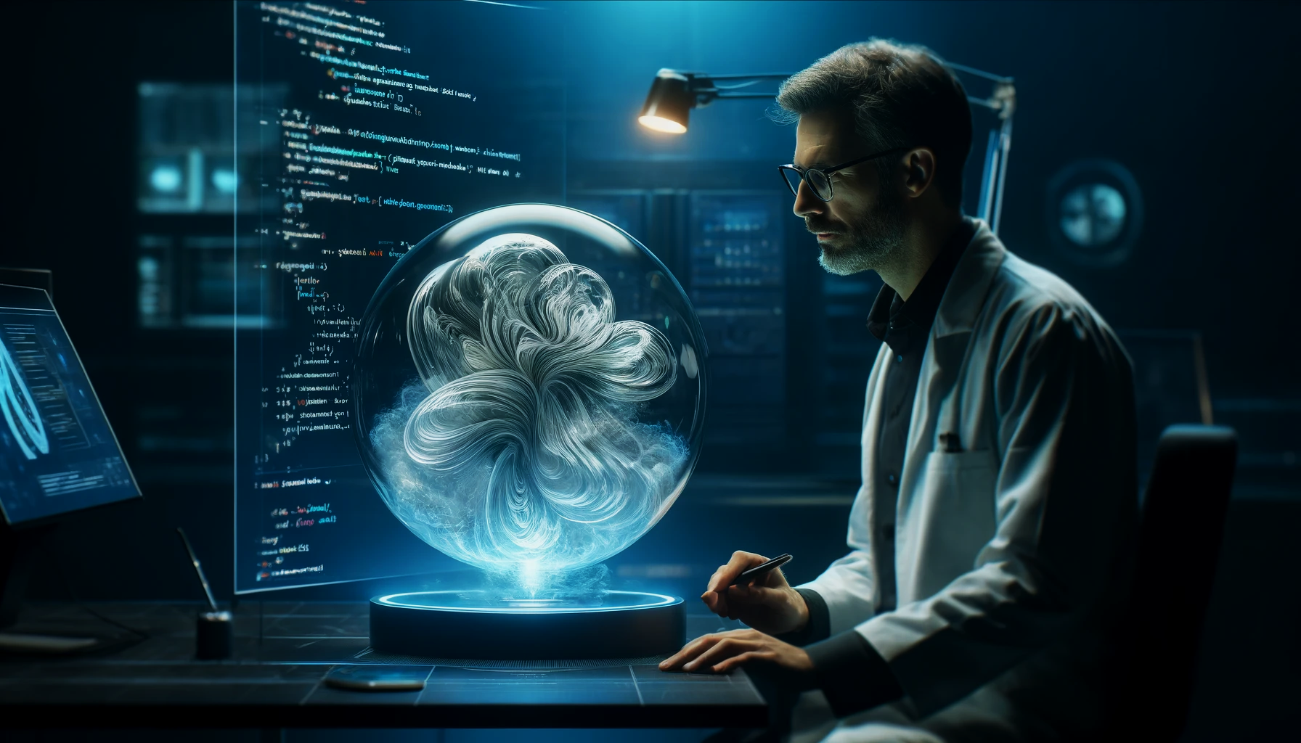
Enhancing Text-to-Image Generation with Fine-Grained Semantic Control
Angad Bajwa | Mehal Agarwal | Hariharan Saravanan

Slide 2
Motivation
Enhance Semantic Accuracy: Address limitations in current models to more accurately reflect complex textual descriptions in generated images.
Advance Model Capabilities: Enhance the AttnGAN model using state-of-the-art technology such as BERT and CLIP models for richer text interpretation and more detailed image outputs.
Widen Application Spectrum: Enable new opportunities in digital art, assistive technology, and content creation by improving image generation technology.

Slide 3
Contents
Introduction to AttnGAN
Introduction to DAMSM
Solution Formulation
BERT-based Text Encoder
CLIP-based Image and Text Encoder
Ablation Studies
Results and Experiments
Analysis and Conclusion

Slide 4
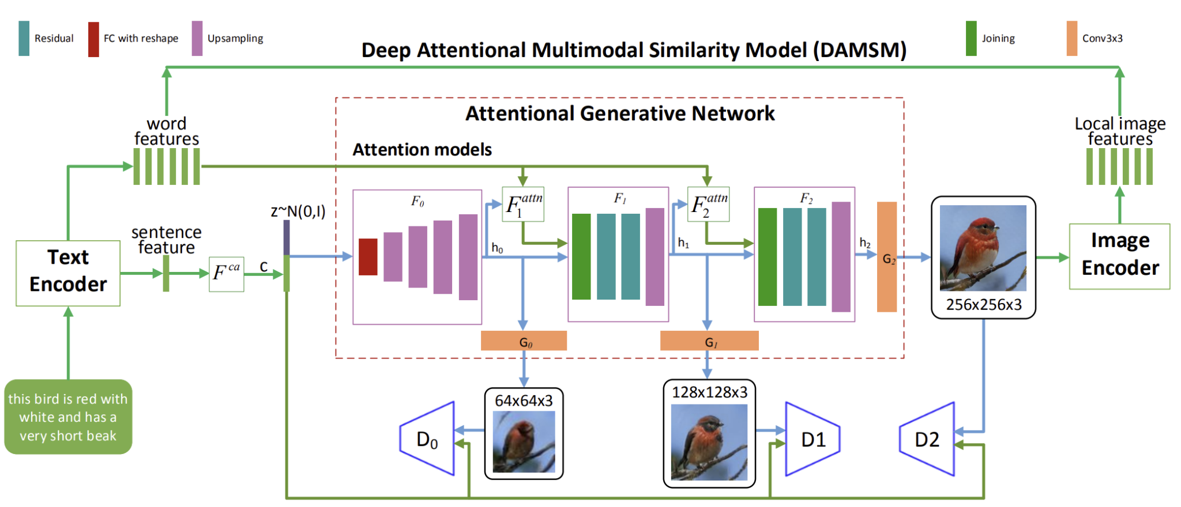
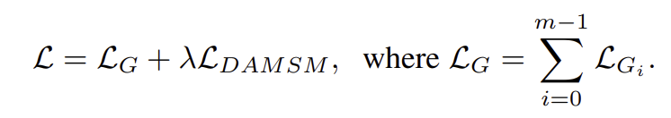
AttnGAN

Slide 5
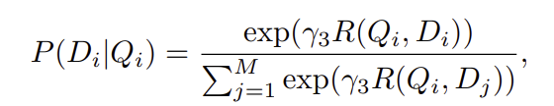
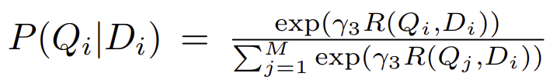
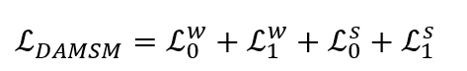
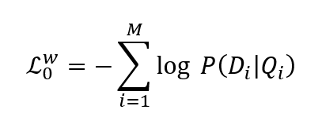
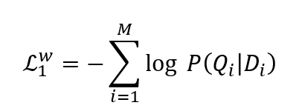
DAMSM (Deep Attention Multimodal Similarity Model)
The DAMSM loss is designed to learn the attention model in a semi-supervised manner, in which the only supervision is the matching between entire images and whole sentences (a sequence of words)
Probability of image Qi being matched with sentence Di
Probability of sentence Di being matched with image Di

Slide 6
Solution Formulation

Slide 7
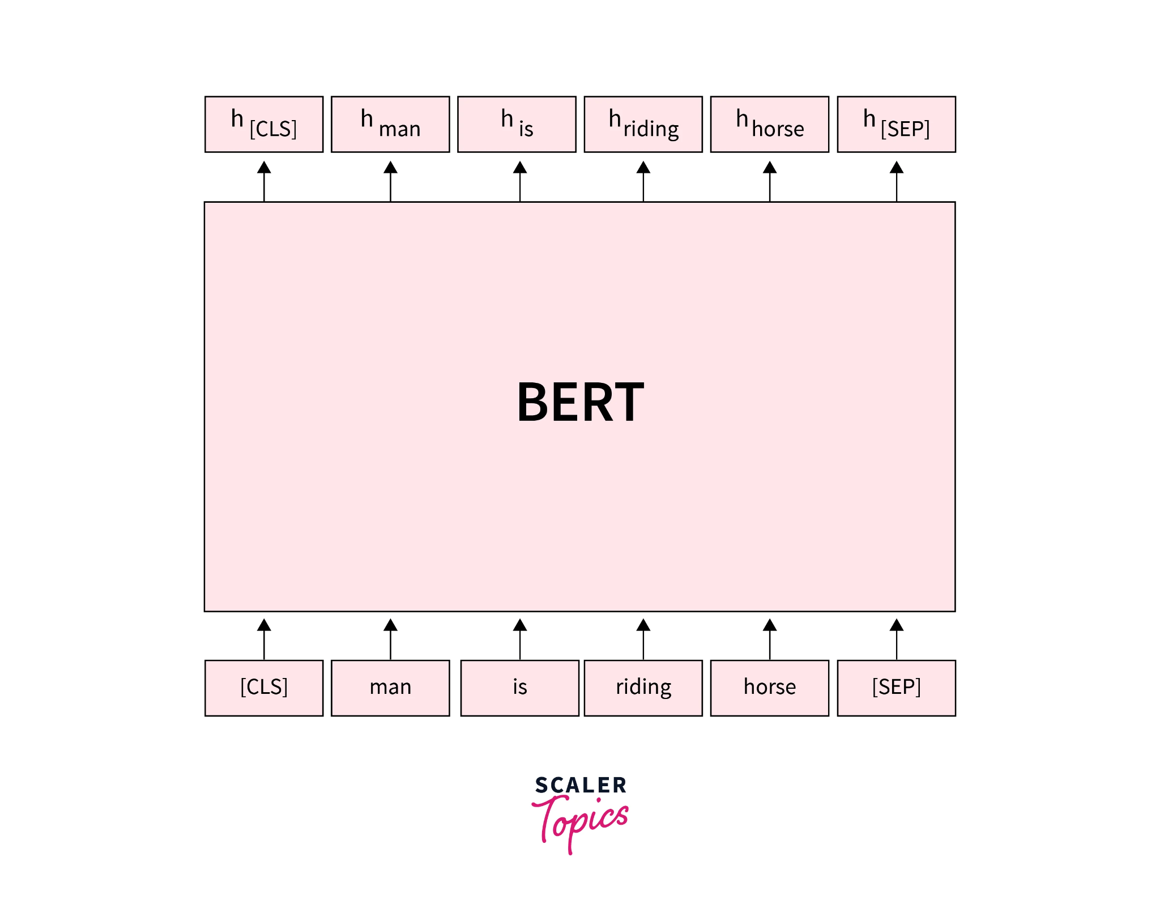
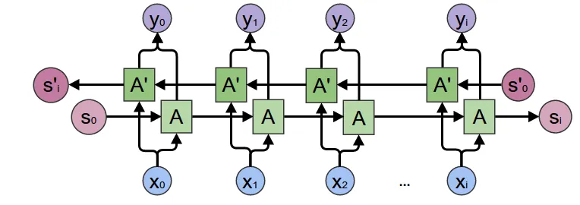
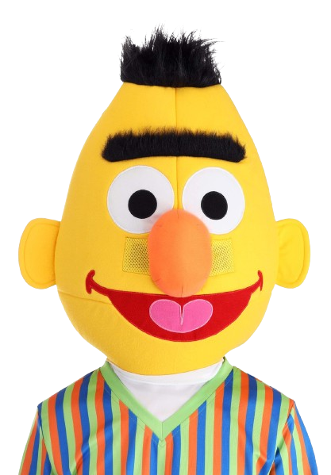
BERT based Text Encoder
Current Approach: Utilizes a bi-directional LSTM network to extract semantic vectors from text descriptions.
Proposed Enhancement: Replace the LSTM with a pretrained BERT model. BERT’s architecture leverages bidirectional context and transformer mechanisms, providing a deeper, more nuanced understanding of text semantics.

Slide 8
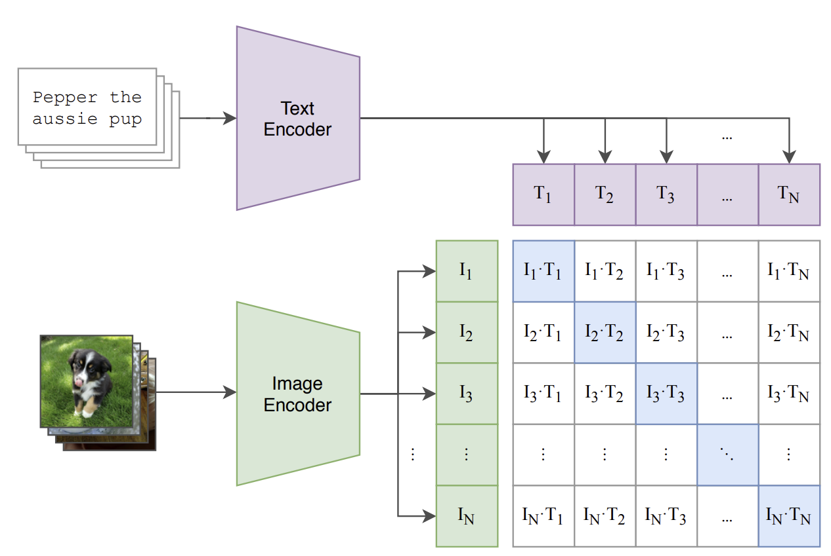
CLIP based Text Encoder
Proposed Enhancement: Replace the LSTM with a pre-trained CLIP text encoder. The text component of CLIP is trained to encode text in a way that matches corresponding visual content, making it highly effective for text-to-image applications.

Slide 9
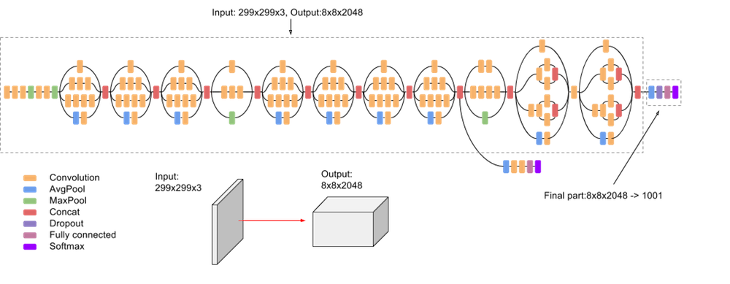
CLIP based Image Encoder
Current Approach: Utilizes a traditional Convolutional Neural Network to map images into semantic vectors. More specifically, the image encoder is built upon the Inception-v3 model pre trained on ImageNet.
Proposed Enhancement: A CLIP model as the new image encoder. Unlike conventional CNNs, CLIP is trained on a diverse range of image-text pairs, enabling it to capture a broad spectrum of visual concepts that are linked to their textual descriptions.

Slide 10
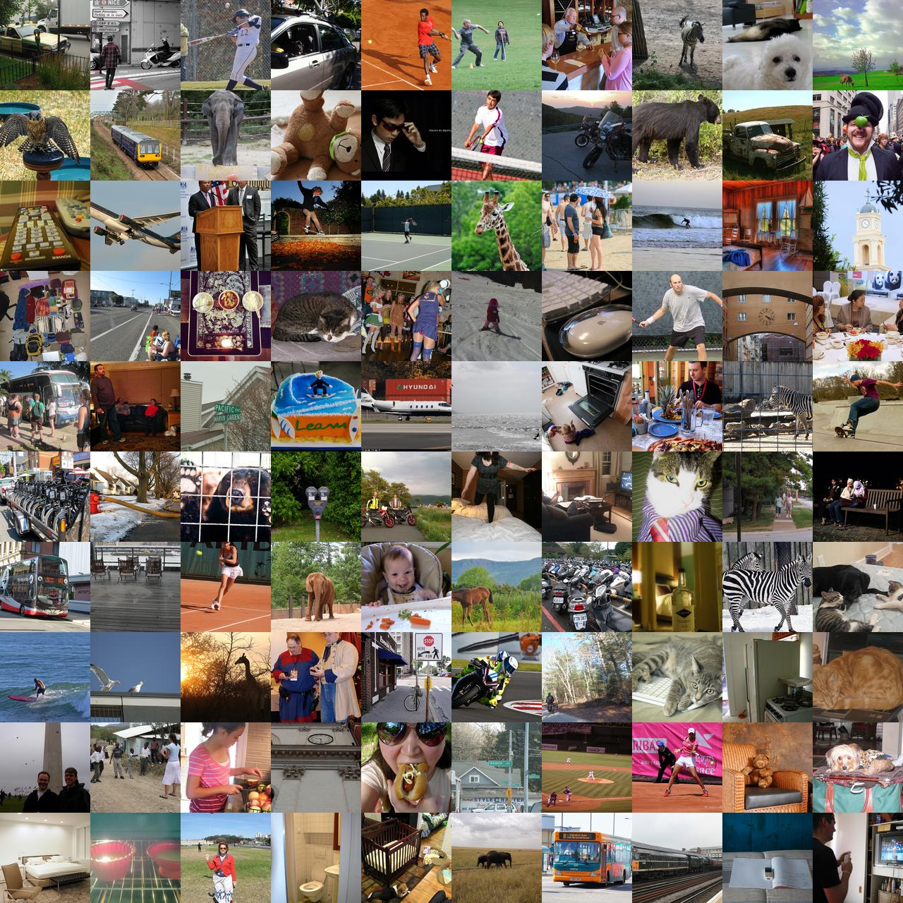
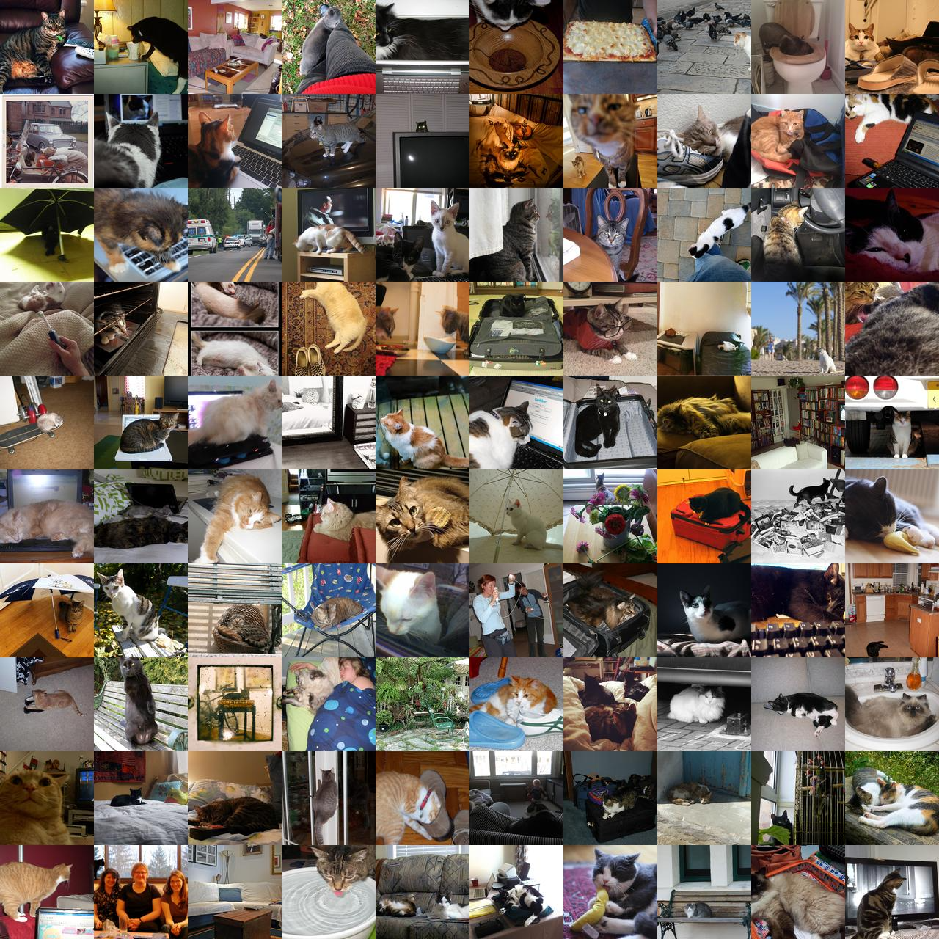
Dataset
Dataset | COCO |  | COCO (Cats)
 | train | test | train | test
Number of samples | 80,000 | 40,000 | 2818 | 560
Captions per image | 5 | 5 | 5 | 5
MS COCO test 2014 dataset
MS COCO (Cats) test 2014 dataset

Slide 11
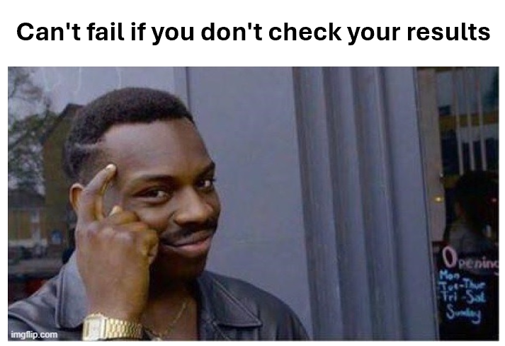
Experiments and Results

Slide 12
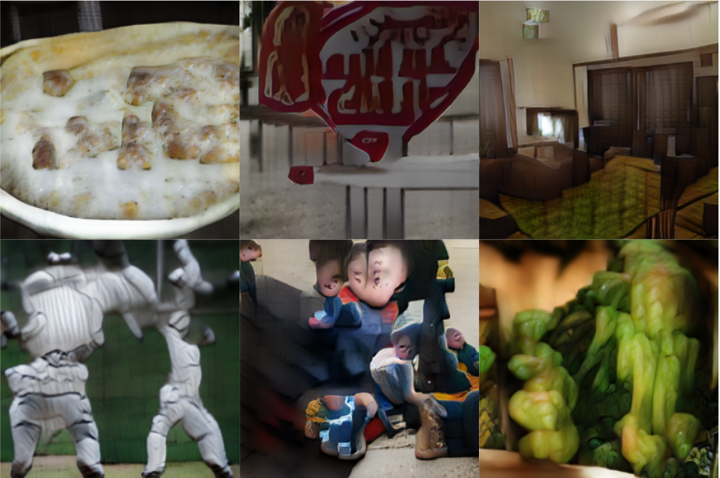
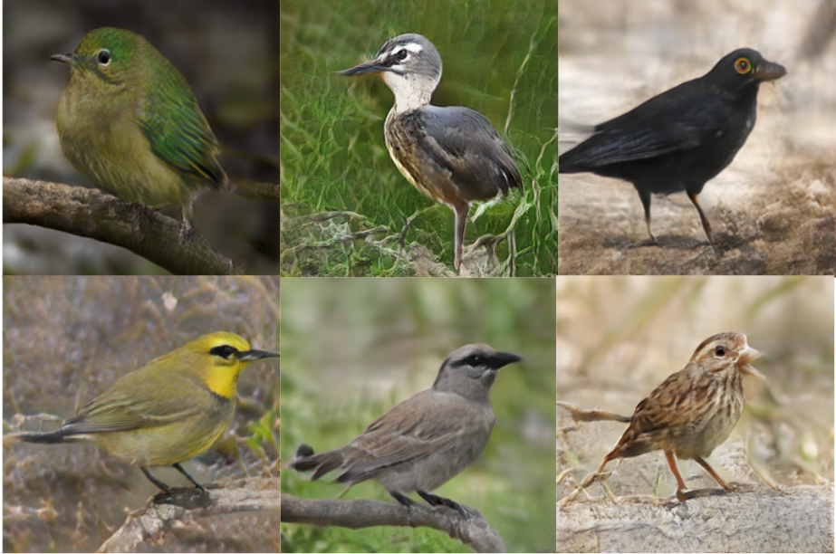
Baseline Implementation using pre trained DAMSM
Baseline Results on full MS-COCO test 2014 dataset
Dataset | Split Size | Inception Score (Ours) | Inception Score (Paper) | FID
COCO | 40k | 23.42 ± 0.76 | 25.89 ± 0.47 | 40.31
CUB | 3k | 4.25 ± 0.66 | 4.36 ± 0.03 | 18.46
Generated Images on the COCO dataset
Generated Images on the CUB dataset

Slide 13
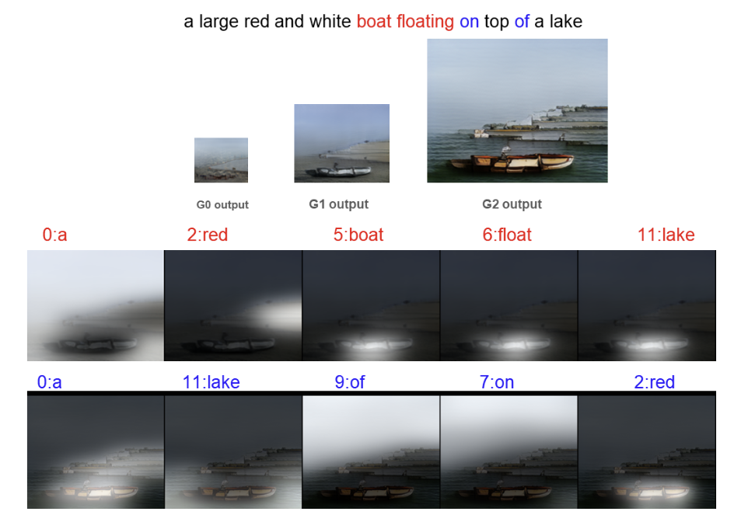
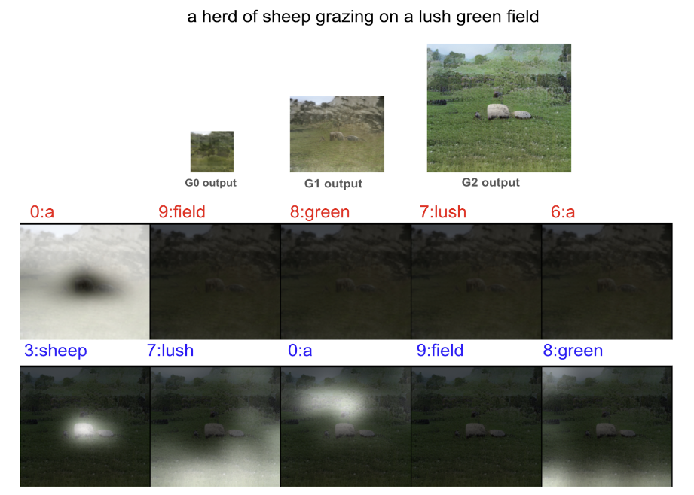
Baseline Implementation using pre trained DAMSM

Slide 14
Experiments on DAMSM
Experiment | Text Encoder | Image Encoder
Baseline (Paper) | LSTM | CNN
BERT-based Text Encoder | BERT | CNN
CLIP-based Text Encoder | CLIP | CNN
CLIP-based Image Encoder | LSTM | CLIP
CLIP-based Image and Text Encoder | CLIP | CLIP

Slide 15
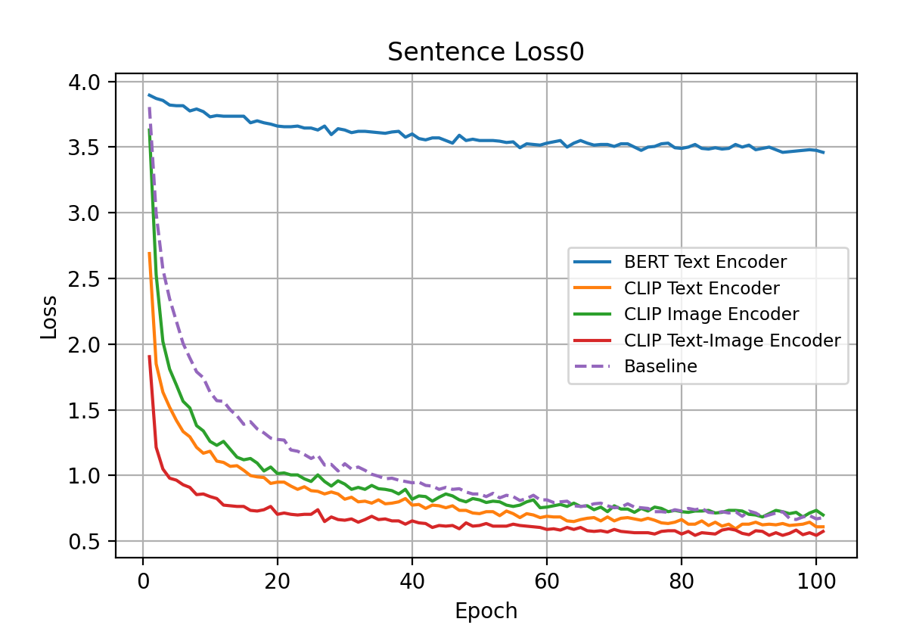
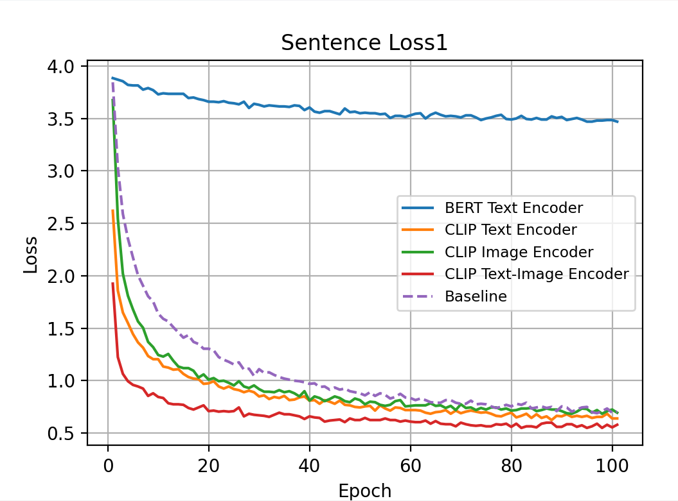
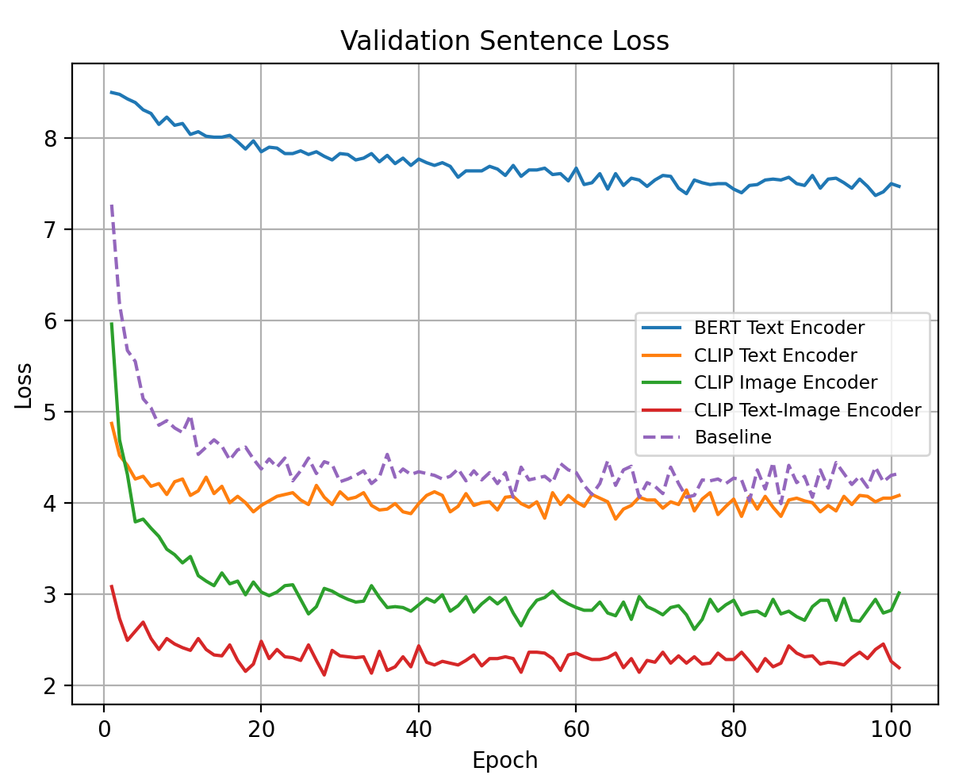
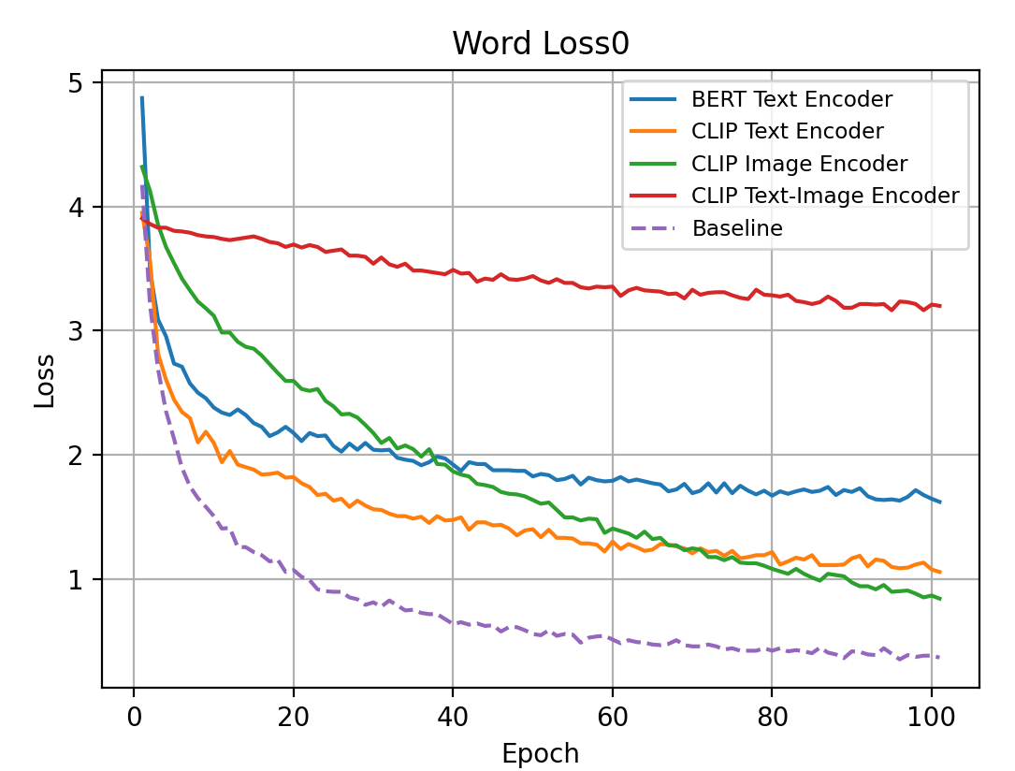
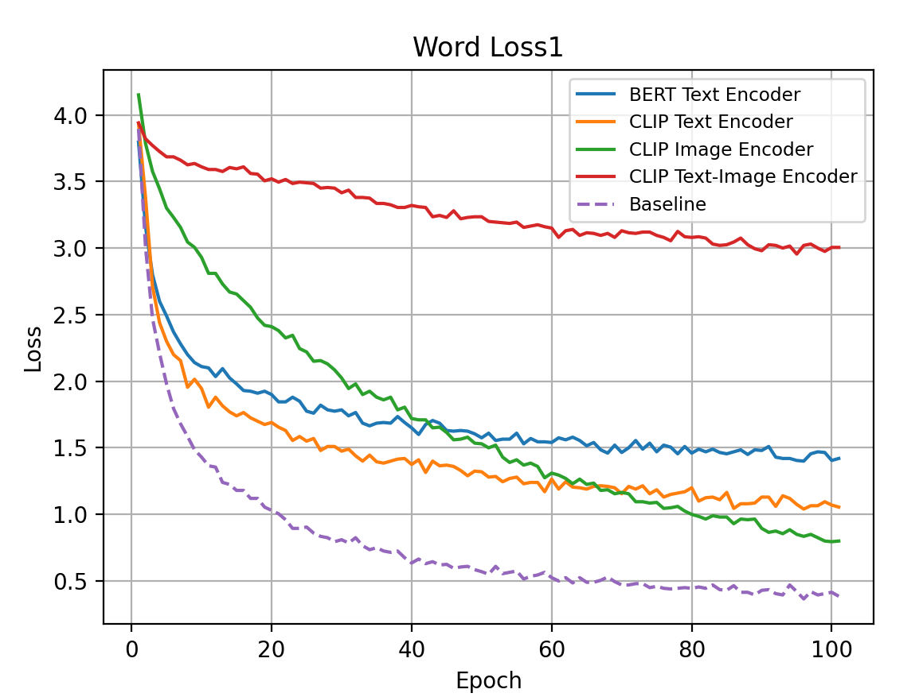
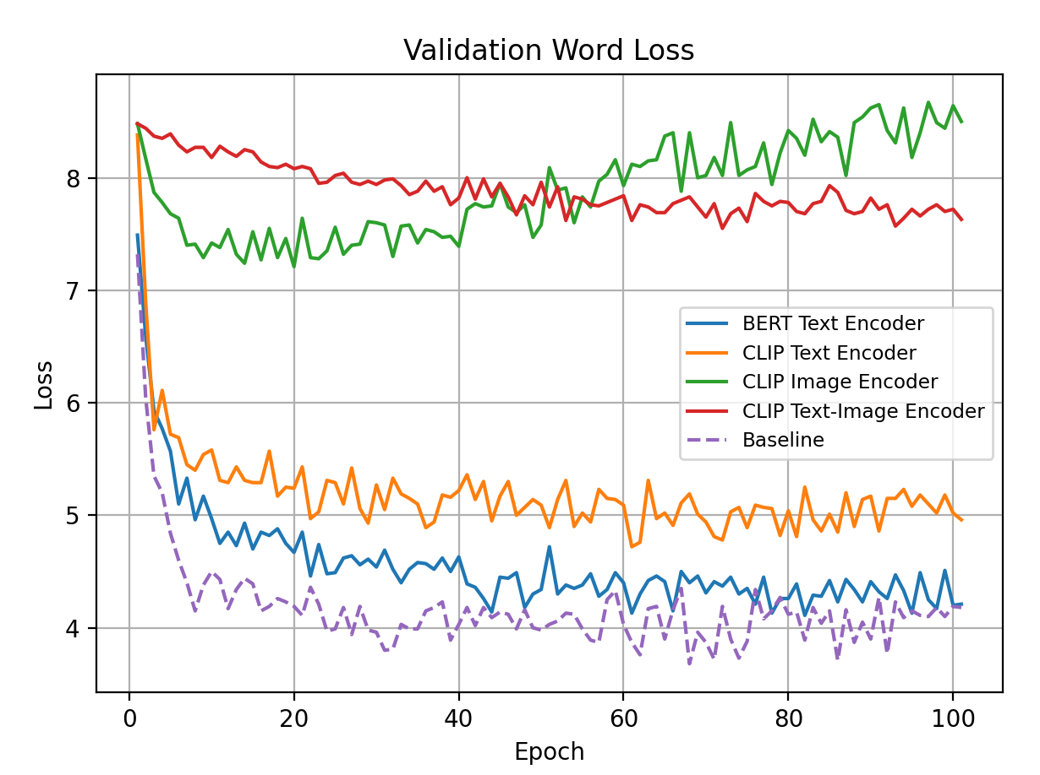
Experiments with DAMSM Model
Notes:
Only on cats

Slide 16
Experiments with DAMSM Model
Experiment | Validation s_loss | Validation w_loss
Baseline (Paper) | 4.424 | 4.177
BERT-based Text Encoder | 7.719 | 4.565
CLIP-based Text Encoder | 4.046 | 5.195
CLIP-based Image Encoder | 3.012 | 7.892
CLIP-based Image and Text Encoder | 2.320 | 7.894

Slide 17
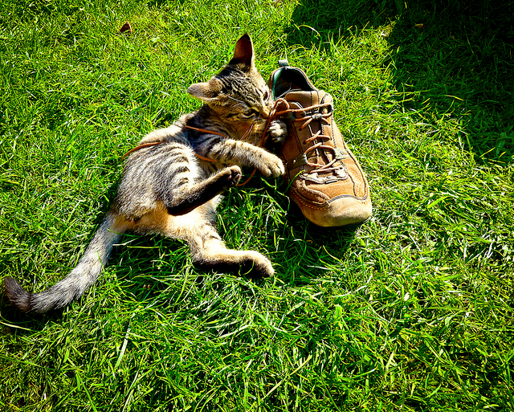
CLIP-based AttnGAN (Ours)
CLIP IMAGE ENCODER
CLIP TEXT ENCODER
A close up of a cat in the grass chewing on a shoestring.

Slide 18
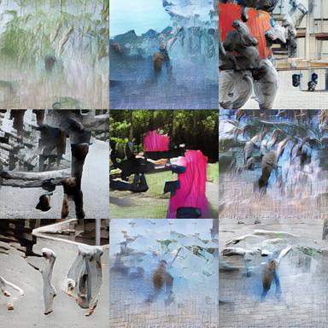
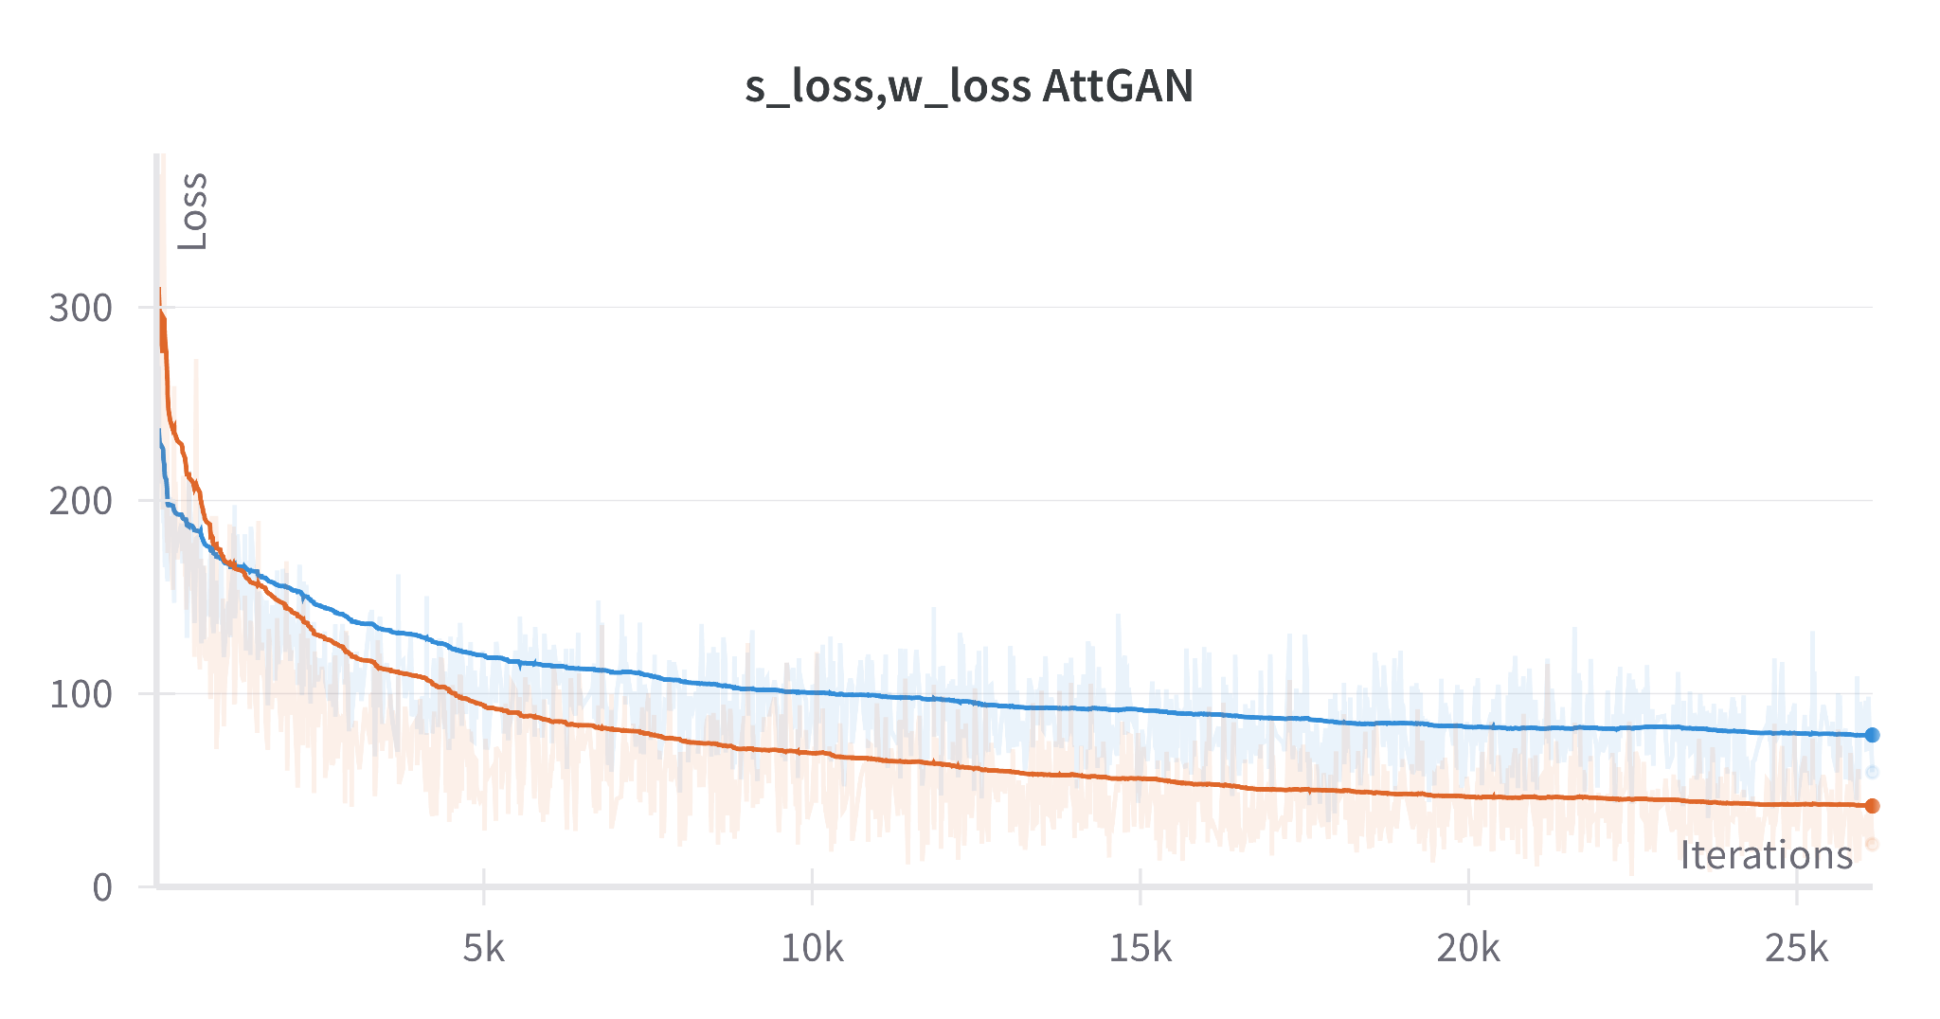
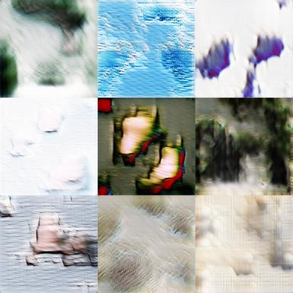
CLIP-based AttnGAN (Ours)
Method | FID | Inception Score
Ours | 257.04 | 6.33 ± 0.65
Paper | 283.43 | 5.23 ± 0.17
— w_loss
— s_loss

Slide 19
Analysis and Conclusion
Experimental Observations:
CLIP based image and text encoders can improve performance of AttGANs as we learn a richer representation of input data which is fed into the GAN network.
Future Work:
Integrate both CLIP and BERT
Use cross attention loss
Scale our approach to all classes
Challenges:
Instability of GAN training (let alone 3 GANs)
Outdated codebase
Computationally Expensive!

